Slide 1
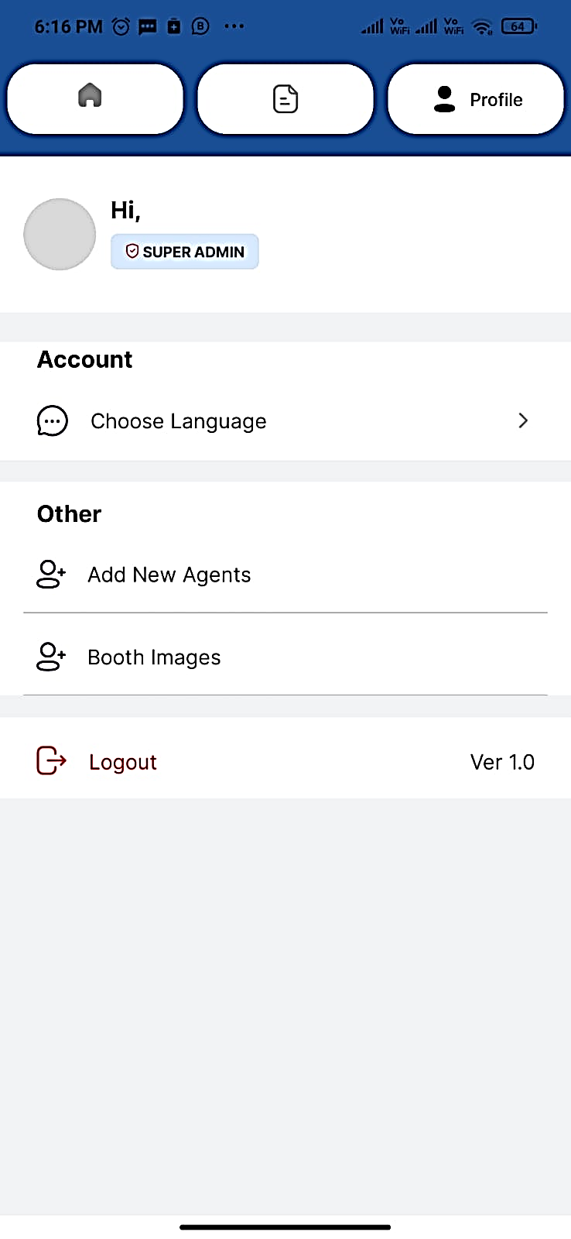
Election App Features
The election app provides various features to streamline the volunteering and voter registration process. From secure login to voter management, the app offers a user-friendly interface to facilitate efficient campaign activities. Made more user-friendly for agents by giving choose language option. Voter Slip generation option.
by Techasoft Pvt. Ltd.

Slide 2
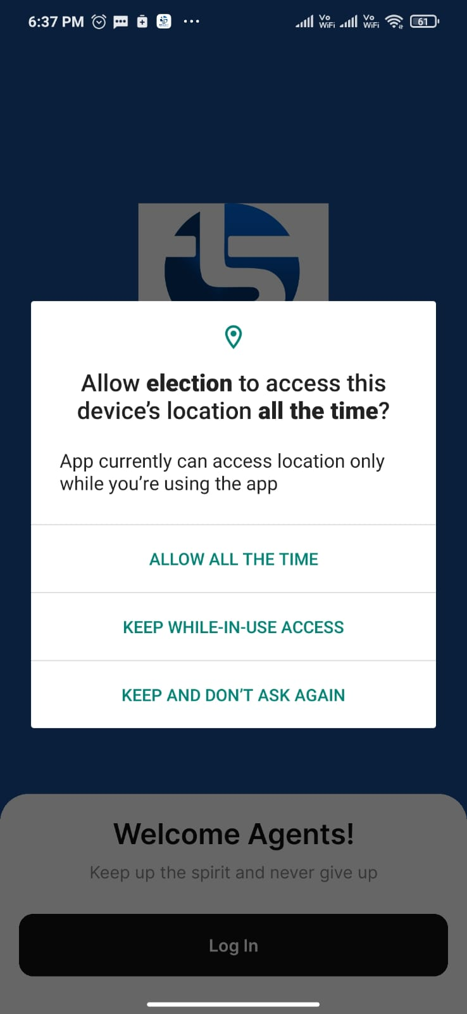
Login
Easy Access
Volunteers can securely log in to the app using their phone and password, gaining access to the home page within seconds.

Slide 3
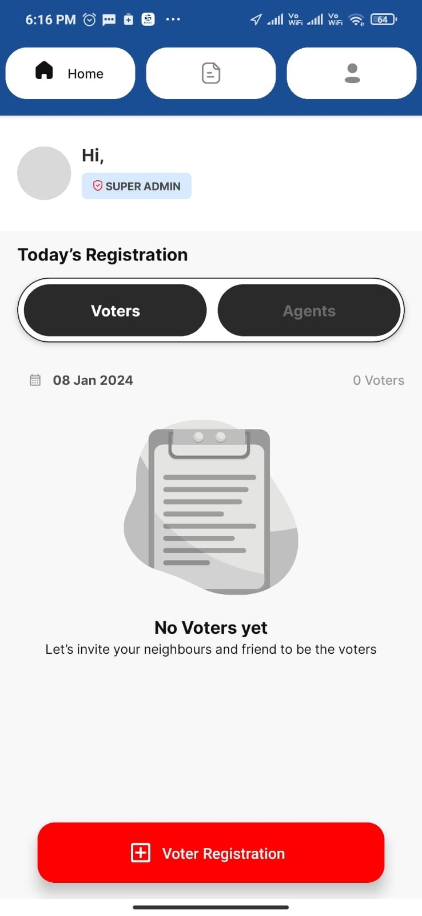
Dashboard
1
Volunteers' Profile
Display profile images, names, and roles for quick volunteer identification and efficient team coordination.
2
Voter Registration
Streamline the process of adding new voters to the system, offering a seamless form for inputting voter details.
3
Voters List for Current Day
Track recent activities by displaying a list of voters added on the current day, including their details and map locations.

Slide 4
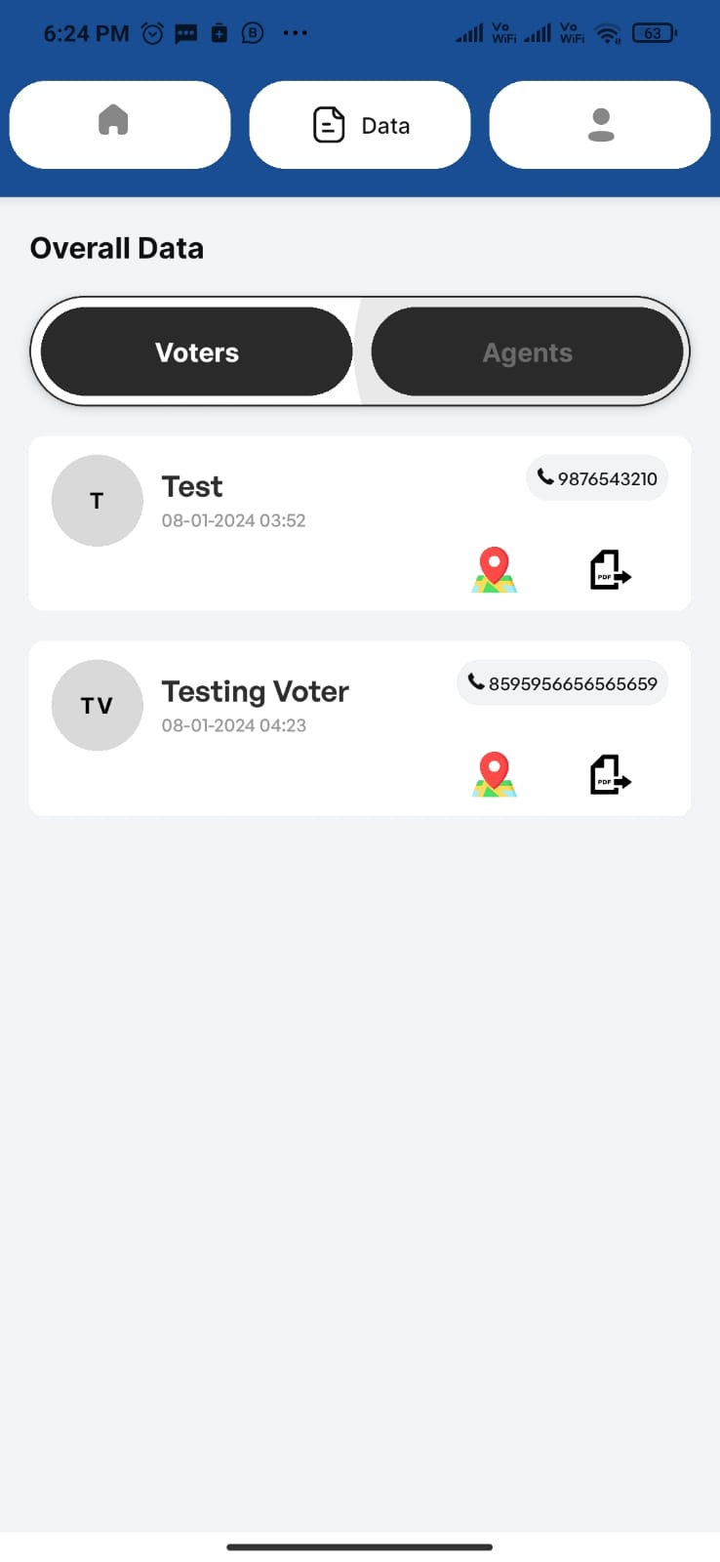
Data Screen
Overview of Voters
Voter Locations
Edit/Update Functionality
Display the complete list of voters added by volunteers, providing a comprehensive view for efficient data management.
Access the map feature to visualize the geographical distribution of voters and plan effective engagement strategies.
Easily edit and update voter information directly within the app's interface, ensuring accurate data records.

Slide 5
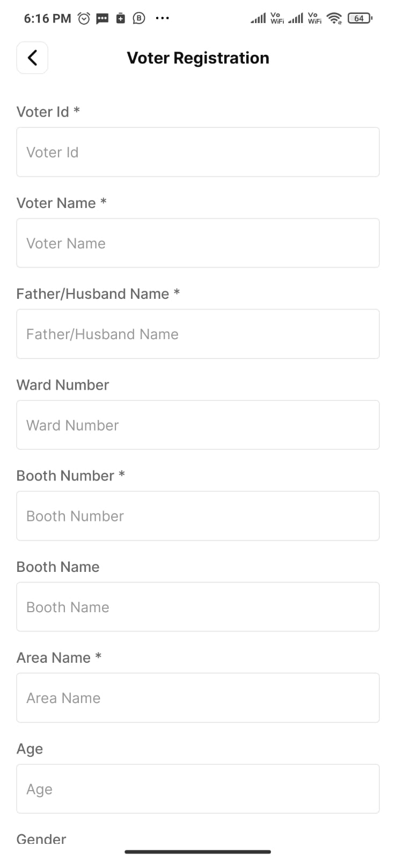
Voter Registration
1
User-Friendly Forms
2
Seamless Save Option
Effortlessly capture essential voter information through well-designed form fields.
Ensure a smooth process with the "Save and Continue" button, allowing volunteers to securely store entered voter details.

Slide 6
Update Voter Registration
Edit Information
Efficient Modifications
Display the voter's current details in editable fields, ensuring accuracy and up-to-date records.
Allow volunteers to easily and securely make modifications to the voter's information using the provided form. Voter Slip Generation option

Slide 7
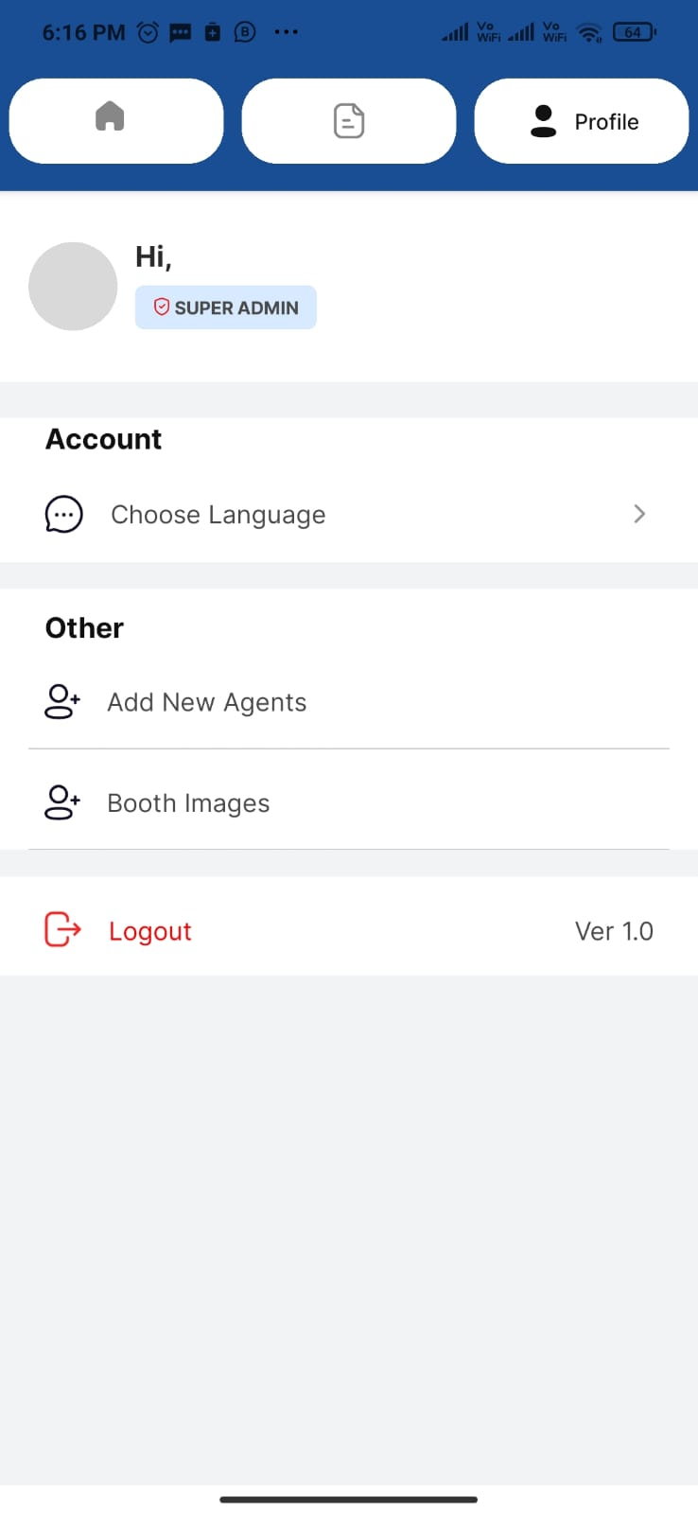
Profile
Volunteer Identification
Display profile images, names, and roles of volunteers for team recognition and effective collaboration. Admin can view the Volunteer exact location in map and monitor them.
Secure Logout Option
Ensure account security with the "Logout" button, allowing volunteers to securely sign out of their accounts.

Slide 8
Conclusion
1
Efficient Voter Management
2
User-Friendly Interface
The app's features enable efficient tracking, registration, and management of voters, optimizing campaign strategies and activities. Graphic representation of collected data through application has given clear picture in predicting the election results.
The app provides a seamless and intuitive interface, enhancing the experience for volunteers engaged in election campaigns. Language option and voter slip generation made the volunteer work more user-friendly.Admin can track and monitor the volunteer work through Google Map Location tracking.

